Slide 1
Predictive analysis of industrial precipitation cycles using population balance and deep learning methods
Vladimir Golubev, Dmitry Chistyakov, Iliya Blednykh
“RUSAL ETC” LLC, Saint Petersburg, Russia
Presented by: Vladimir Golubev

Slide 2
Contents
Problems of automated control of the precipitation process
Revised Population Balance Model
Recurrent Neural Network
PrecipExpert tool
Comparison of the predictions made using population balance and long short-term memory methods
Notes:
1

Slide 3
Introduction
Existing advanced control systems are not very efficient for prediction and optimal control of Bayer process precipitation areas; limiting productivity and product quality optimisation, and restricting the sustainable development of alumina refineries.
The primary aim of this study was to develop reliable methods and tools for predicting aluminum hydroxide particle size distribution (PSD) and liquor productivity in the precipitation circuits of existing refineries.

Slide 4
Process Specifics Causing Errors in PSD and Liquor Productivity Control in the Precipitation Area
Process specifics | Examples
Many noisy signals with low Signal-to-Noise ratio | Noise can be caused by: varying solids concentration, injection of fine particles after precipitator chemical cleaning, variable liquor impurities, daily temperature fluctuations and equipment breakdowns
Low Time-to-Steady-State value | The rate of nucleation and the rate of particle removal from the system are low with respect to the total number of crystals
Inability to directly measure key parameters | Key parameters such as the quality of the crystal surface, the number of true nuclei and active surface area cannot be measured directly
Big difference in sampling time intervals of parameters | Flow is measured in intervals of minutes; A/C and temperature are measured in hours; PSD is measured in days or weeks
Presence of parameters with a strong functional correlation | Chemical recovery and PSD are functionally related, i.e. crystal coarsening causes decrease in recovery and vice versa, making their simultaneous control challenging

Slide 5
Two Methods of Simulation
Population Balance Model
Advantages
Strong physical and chemical principles, user friendliness
Disadvantages
High computational costs, complexity (for tuning)
Deep Learning Method
Advantages
Great generalizing ability, high performance
Disadvantages
Impossibility of interpreting the forecast, loss of quality with time

Slide 6
Classical Population Balance Model
1. Generalized equation
2. Growth rate model
$\frac{∂n_{i}}{∂t}+G\frac{∂n_{i}}{∂u}=B_{i}−D_{i}$,
$$G=k_{0}exp\left(\frac{E_{act}}{RT}\right){\left(\frac{A−A_{eq}}{С}\right)}^{z1}$$
3. Agglomeration model
$${\left.\frac{∂n_{i}}{∂t}\right|}_{agg}=\frac{1}{2}\int_{0}^{v}{β\left(v−u,u\right)∙n\left(v−u\right)∙n\left(u\right)du}−n\left(v\right)\int_{0}^{N}{β\left(v,u\right)∙n\left(u\right)du},$$
$$β(v,u)=k_{c}\frac{G}{β_{4}\left(L_{v}^{1/3}+L_{u}^{1/3}\right)}$$
$$B_{0}=k_{n}{\left(\frac{A−A_{eq}}{C}\right)}^{z2}S_{sl}$$
4. Secondary nucleation model
${\left.\frac{∂n_{i}}{∂t}\right|}_{b.br}={\left(\frac{L_{i+1}}{L_{i}}\right)}^{3}ϑ_{i+1}n_{i+1}−ϑ_{i}n_{i}$,
$θ\left(t,u\right)=k_{b}γ^{p}{\overline{m}}_{1}∙F\left(u\right)$.
5. Binary breakage model

Slide 7
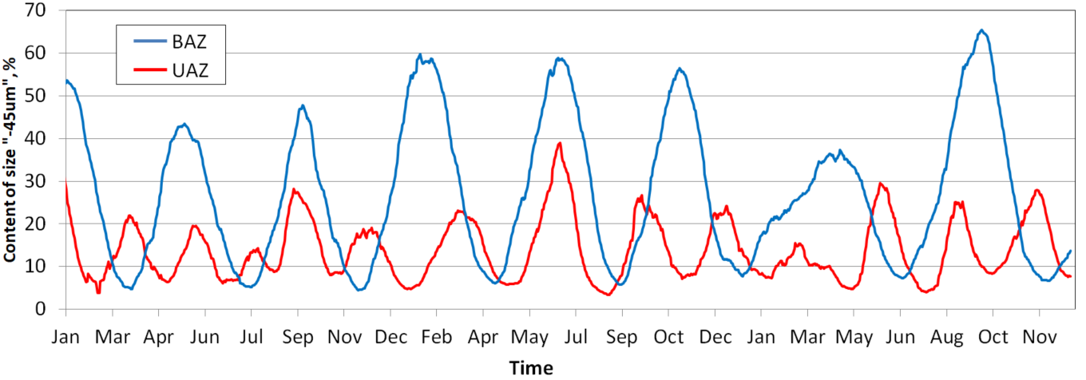
PSD Oscillations
Fluctuations in the seed – 45 μm fraction at the Kamensk-Uralsky (UAZ) and Bogoslovsk (BAZ) alumina refineries over three years.

Slide 8
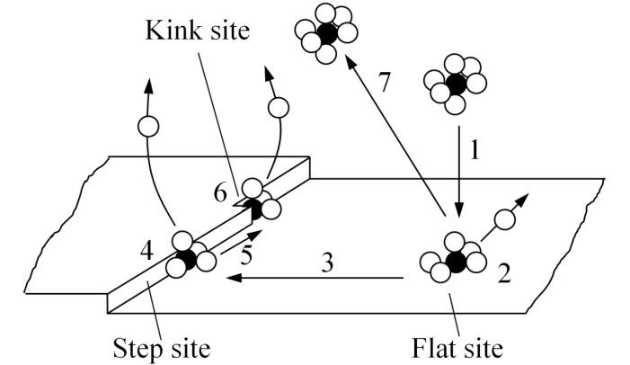
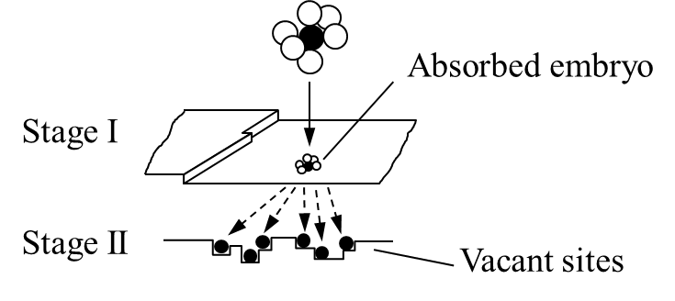
Birth-and-Spread Mechanism
Movement of the solvated solute molecule
Sequence of bonding of nuclei on the sites resulting from birth-and-spread

Slide 9
Updated PBM Model
1, 2, 3. Unaltered
4. Updated secondary nucleation model accounting for birth-and-spread mechanism
$$B_{0}=\left\{k_{n}{\left(\frac{A−A_{eq}}{C}\right)}^{z2}S_{sl}\right\}\left\{1−k_{s}∙\sum_{i}{\left\{S_{f.i}\left[1+(\overline{μ}−1)f_{a.i}\right]\right\}}\right\}$$
5. Updated binary breakage model accounting for fraction of agglomerates in population
${\left.\frac{∂n_{i}}{∂t}\right|}_{b.br}={\left(\frac{L_{i+1}}{L_{i}}\right)}^{3}ϑ_{i+1}n_{i+1}−ϑ_{i}n_{i}$,
$$θ\left(t,u\right)=k_{b}γ^{p}{\overline{m}}_{1}∙F\left(u\right)∙f_{a}\left(t,u\right),$$
$$F\left(u\right)=\frac{1}{δ\sqrt{2π}}exp\left(−\frac{{\left(L_{u}−L^{∗}\right)}^{2}}{2δ}\right).$$

Slide 10
Recurrent Neural Network
Data structure
Historical period,
Archive data
Forecast period,
Estimated data
User
assumptions
Parameter 1 (inlet)
Parameter 2 (inlet)
Parameter 3 (inlet)
Network
outputs
(predictions)
Parameter 4 (outlet)
Parameter 5 (outlet)
Neural network
inlets
Data point
The moment
of forecasting
Forecast
horizon

Slide 11
Long-Short Term Memory
y_{t}
Output
LSTM cell
LSTM cell
LSTM cell
C_{t-1}
Scaling
Sum
C_{t}
$$tanh$$
Cell state
Next
cell state
Sigmoid
$$$$
$$$$
$$tanh$$
$$$$
Forget Gate
Input Gate
Input Modula-tion Gate
Output Gate
h_{t-1}
h_{t}
Hidden state
Next
hidden state
x_{t}
Input

Slide 12
PrecipExpert Tool

Slide 13
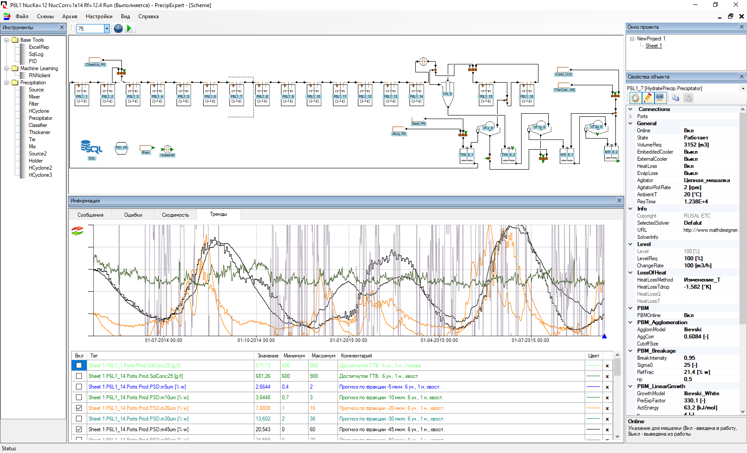
Long-Term Prediction Using PBM

Slide 14
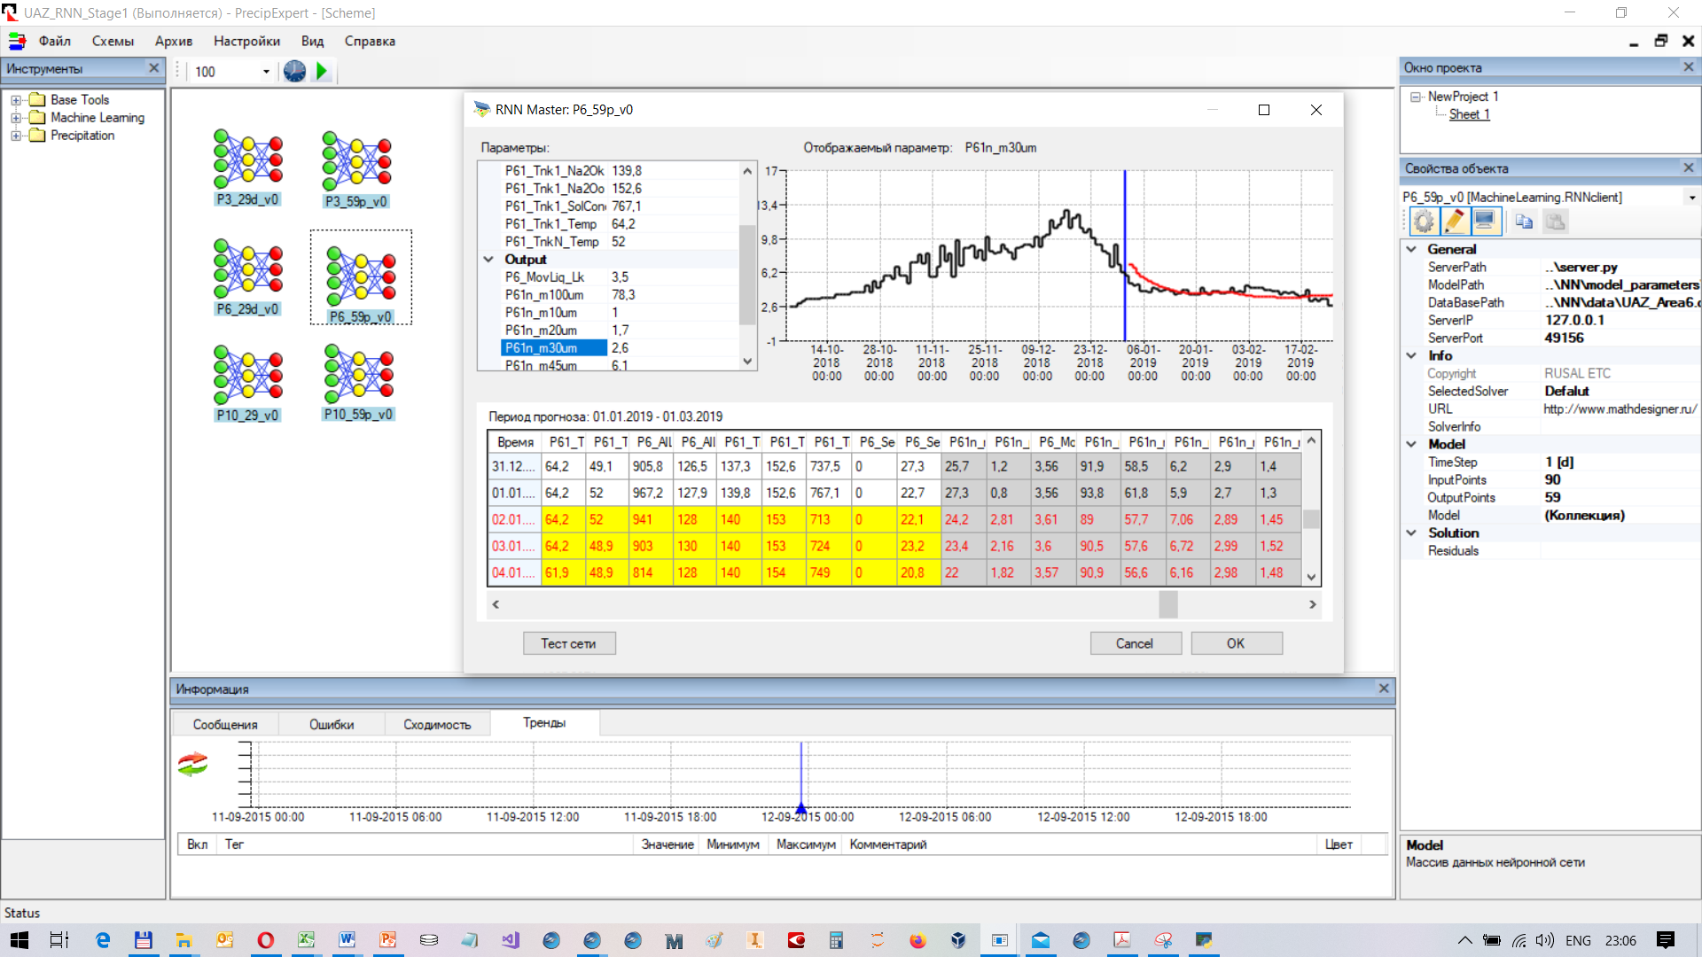
Set of LSTM Models for the Precipitation Area

Slide 15
Parameters Enabling Best 60-day Prediction Using LSTM Model
Inlet Parameters | Outlet Parameters
Temperature in the head precipitator | + 150 μm, %
Temperature in the tail precipitator | - 100 μm, %
Pregnant liquor. Volume Flow | - 63 μm, %
Pregnant liquor. A | - 45 μm, %
Pregnant liquor. C | - 30 μm, %
Pregnant liquor. S | - 20 μm, %
Solids content in the head precipitator | - 10 μm, %
Seed from other areas. Volume Flow | Spent liquor A/C
Seed from other areas. - 45 μm

Slide 16
Short-Term Predictions Using LSTM Network
Precipitation Line #6/1, 60-day prediction: content of - 45 μm, %
um, %

Slide 17
Comparison of Predictions Using PBM and LSTM Methods
Precipitation Line #6/1, 1.5-year prediction: content of - 45 μm, %
8
3
6
1
4
2
5
7
9

Slide 18
Comparison of Predictions Using PBM and LSTM Methods
Precipitation Line #6/1, 1.5-year prediction: A/C
3
5
1
7
8
2
4
6
9

Slide 19
Accuracy of 60-day Predictions Using LSTM Method
Standard deviation for the best LSTM networks, abs. %
Parameter | Area #3 | Area #6 | Area #10
+ 150 µm | 1.39 | 1.37 | 1.30
- 100 µm | 4.55 | 4.94 | 4.59
- 63 µm | 6.43 | 6. 47 | 6.68
- 45 µm | 4.97 | 4.51 | 5.34
- 30 µm | 2.32 | 2.47 | 3.54
- 20 µm | 0.917 | 1.09 | 1.77
- 10 µm | 0.263 | 0.260 | 0.389
Spent liquor α_{k}* | 0.090 | 0.105 | 0.098
* α_{k} = 1.645⋅C_{Na2O}/C_{Al2O3} = 106/102/(A/C)

Slide 20
Conclusions
The population balance model of Bayer precipitation circuits has been improved for pregnant liquors with low A/C ratio. Updated equations for secondary nucleation and particle breakage were proposed which account for surface quality and particle strength through the fraction of agglomerates in the population. The model accurately predicts particle PSD oscillations and liquor productivity in an industrial precipitation circuit.

Slide 21
Conclusions
Recurrent neural networks are effective for mid-term prediction of spent liquor A/C ratio and PSD of product aluminum hydroxide. A set of LSTM models was trained with historical data from the UAZ refinery. The average correlation coefficient obtained was > 0.93 for - 45 µm fraction for 60-day predictions.
PrecipExpert software has been developed; enabling the development of models and calculations using both models.

